Slide 1
STATE DESIGN PATTERN
PRESENTED BY:
ZAINABKHAN (FA22-BSE-032)
MANAHIL TARIQ (FA22-BSE-050)
ANUM HAMEED (FA22-BSE-048)

Slide 2
INTRODUCTION:
Category:
Behavioral Design Pattern
Intent:
Allow an object to alter its behavior when its internal state changes. The object will appear to change its class.
Use Case: When an object must change behavior depending on its current state and avoid complex if/else or switch logic.

Slide 3
WHY USE STATE PATTERN?
Avoids large conditionals.
Each state is encapsulated in a separate class.
Promotes open/closed principle (open for extension, closed for modification).
Makes code easier to maintain and scale.

Slide 4
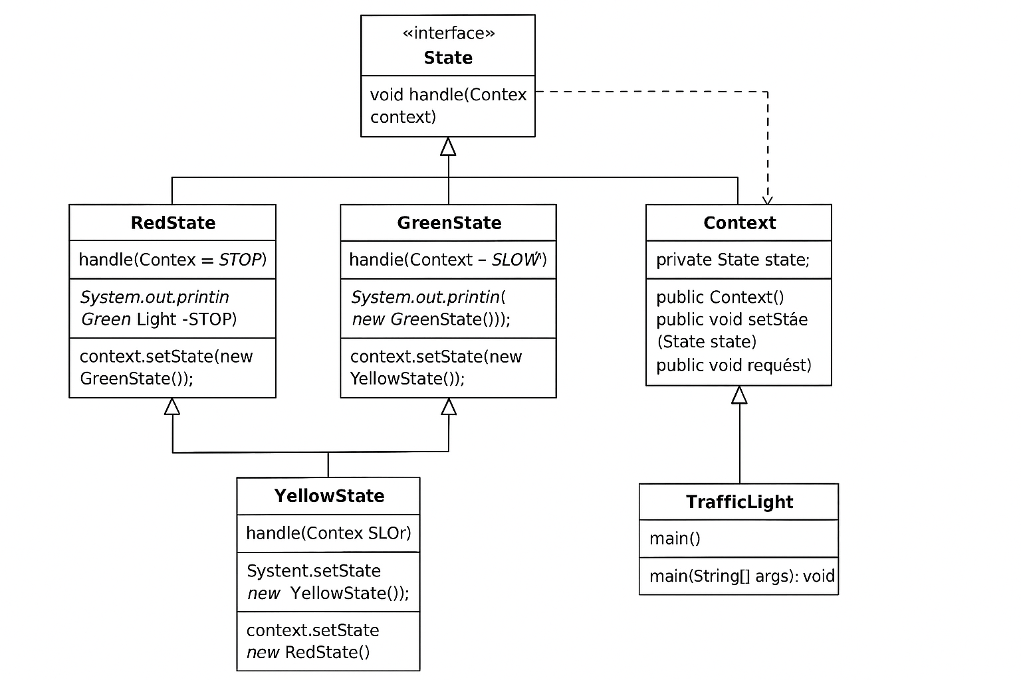
UML DIAGRAM

Slide 5
CODE WALK TROUGH
interface State {
void handle(Context context);
}
public void handle(Context context) {
System.out.println("Red Light – STOP");
context.setState(new GreenState());
}

Slide 6
RED STATE CONCRETE STATE
public void handle(Context context) {
System.out.println("Red Light – STOP");
context.setState(new GreenState());
}

Slide 7
CONTEXT:
public void request() {
state.handle(this);
}

Slide 8
AI- ASSISTED SNIPPET
Context light = new Context();
for (int i = 0; i < 5; i++) {
light.request();
}

Slide 9
REAL WORLD MAPPING
ATM MACHINES
TRAFFIC LIGHTS
UI COMPONENT (BUTTON, MOUSE CLICK)
GAMES

Slide 10
AI DEVELOPER PROSPECTIVE
Would an AI developer naturally use this pattern?
Yes, because:
It simplifies logic through encapsulation.
Promotes clean, readable code—ideal for auto-generation.
Tools like ChatGPT often suggest this pattern to handle dynamic state transitions in UI, games, or workflow engines.

Slide 11


